Slide 1
FUNCTIONS
The function is like a mini-program within a program
(Two types of functions basically.)
- built-in function ( len() , Input() , print())
user-made function : There are the function which a user defines

Slide 2
FUNCTION SYNTAX
def hello():
print('Howdy!')
print('Howdy!!!‘)
PRINT(‘happy coding’)
-Calling the Function
hello()

Slide 3
return Values and return Statements
When you call the len() function and pass it an argument such as 'Hello', the function call evaluates to the integer value 5, which is the length of the string you passed it. In general, the value that a function call evaluates to is called the return value of the function
Basically , The return statement is used to exit a function and go back to a place from where it was called.
When creating a function using the def statement, you can specify what the return value should be with a return statement. A return statement consists of the following:
• The return keyword
• The value or expression that the function should return

Slide 4
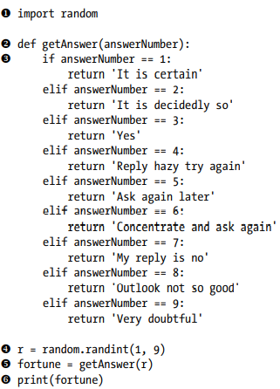
EXAMPLE

Slide 5
LISTS
Lists are used to store multiple items in a single variable.
Lists are created using square brackets.
For Example:
(1)mylist = [“bus", “car", "cherry"]
This mylist variable is of list type that has string values to it.it may contain values of different type in single list.
That’s why it’s second definition is “collection of different datatype”.
(2) mylist = [ 2, 2.5 , ‘python’,’java’,’javascript’,’c++’]

Slide 6
LIST SLICING
As you have sliced the string you can slice the lists values as well.
List value are accessed by index starting from 0 as first index
In Previous Example: mylist[0] will return the first value present in the list. “bus” in first example.
Len(mylist) will return the number of elements present inside the list
SLICING is done using a colon ( : ) inside mylist square brackets.
For Example: print(mylist[0:3]) it will return value from 0 to 3 that is

Slide 7
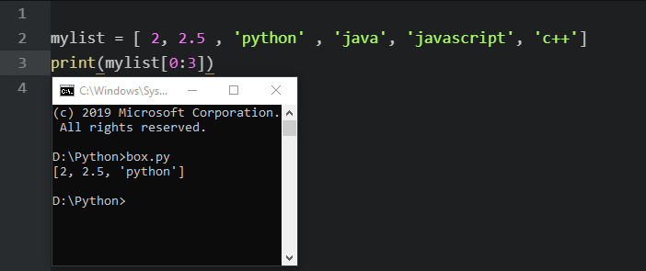
If we want to access all elements index will always (len(mylist) – 1)

Slide 8
SLICING examples
Mylist[0:3] => returns first three values
mylist[1:2] => return values from 2 to 3
mylist[:] => return whole list
mylist[:len(mylist)-1] => return whole from 0 index up to the len(mylist)-1
mylist[-1] => it will return last value present in mylist

Slide 9
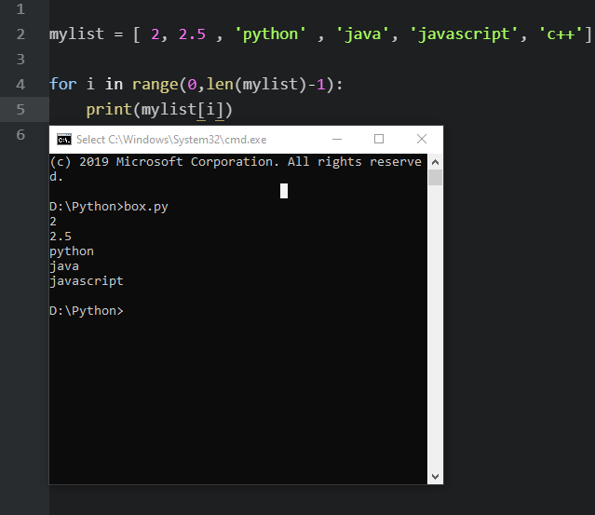
Iterating lists
It is always recommended to use for loop for lists.
Using range function we can provide range.
It is also possible to access value without range function
By writing for i in mylist: where (i) has access to values instead of indexes.

Slide 10
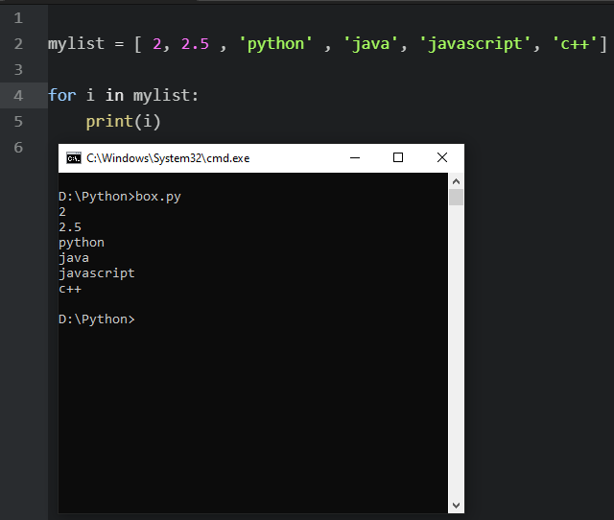

Slide 11
More on lists list has built-in methods
append() => inserts the value at the end of list
clear() => clears the list but not clear the list variable
copy() => copies all the elements from a list
count() => numbers of times the value appears
extend() => adds multiple elements at the end of list
index() => return the index of a variable
insert() => adds the element at specified value
pop() => removes the element at the specified index
remove() => removes the item with specified value
reverse() => reverses the order of the list
sort() => sorts the lists

Slide 12
DICTIONARIES
=> It is basically a flexible way to organize data.
=> In lists we had indexes and values were being accessed through indexes and they were only of type integer.
=> Value can be accessed in dictionary by indexes(called as keys ) and they can be of any time.

Slide 13
SYNTAX FOR DICTIONARY
dict1 = {key : value , key1:value}
The dictionary is assigned using curly braces
It is important to note that for every value key will be different and value can be same.

Slide 14
DICT vs LIST
Unlike lists, items in dictionaries are unordered. The first item in a list named spam would be spam[0]. But there is no “first” item in a dictionary. While the order of items matters for determining whether two lists are the same, it does not matter in what order the key-value pairs are typed in a dictionary. Enter the following into the interactive shell.
>>> spam = ['cats', 'dogs', 'moose']
>>> bacon = ['dogs', 'moose', 'cats']
>>> spam == bacon False
>>> eggs = {'name': 'Zophie', 'species': 'cat', 'age': '8'}
>>> ham = {'species': 'cat', 'age': '8', 'name': 'Zophie'}
>>> eggs == ham True
Because dictionaries are not ordered, they can’t be sliced like lists. Trying to access a key that does not exist in a dictionary will result in a KeyError error message, much like a list’s “out-of-range” IndexError error message. Enter the following into the interactive shell, and notice the error message that shows up because there is no 'color' key.

Slide 15
Most used methods
keys() => returns all keys of a dict
values() => returns all values of a dict
items() => returns both
get() => check if key does exist if not it will make a key

Slide 16
MORE ON DICTIONARIES

